Slide 1

Notes:
© Copyright, ESL Lifeline 2020. For use by purchase of product only. Visit TpT for more details.

Slide 2
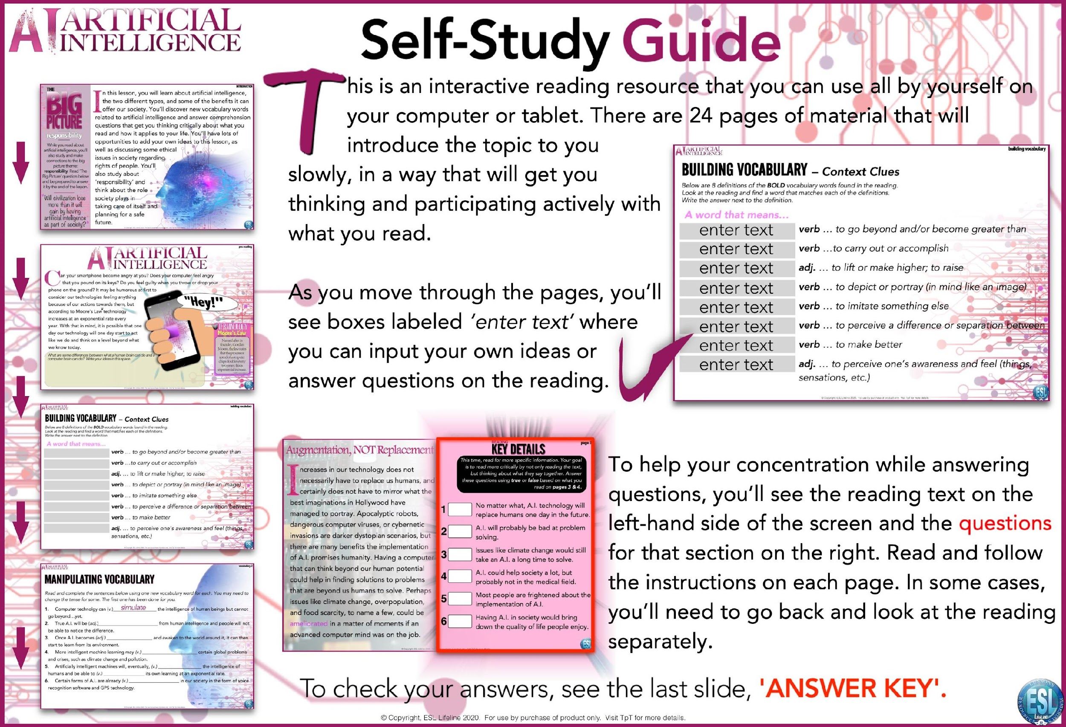
Notes:
© Copyright, ESL Lifeline 2020. For use by purchase of product only. Visit TpT for more details.

Slide 3

Notes:
© Copyright, ESL Lifeline 2020. For use by purchase of product only. Visit TpT for more details.

Slide 4
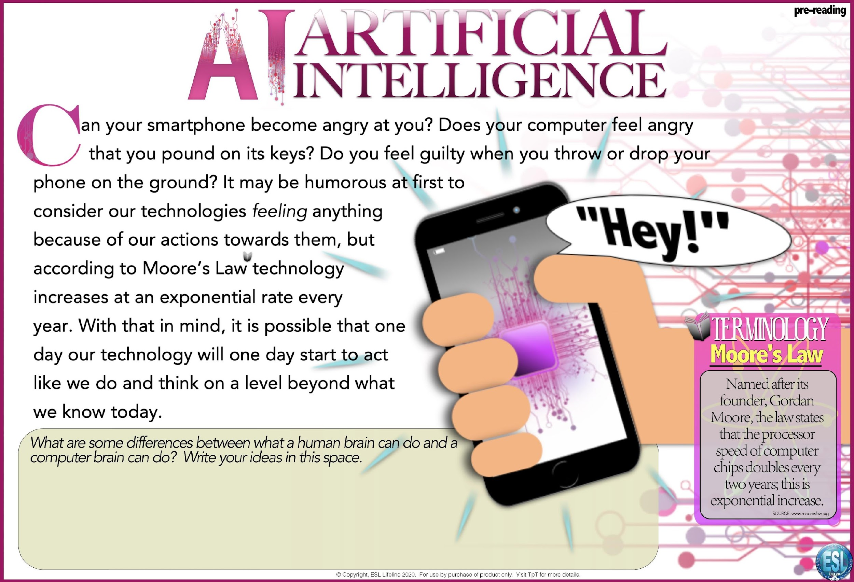
enter text
Notes:
© Copyright, ESL Lifeline 2020. For use by purchase of product only. Visit TpT for more details.

Slide 5
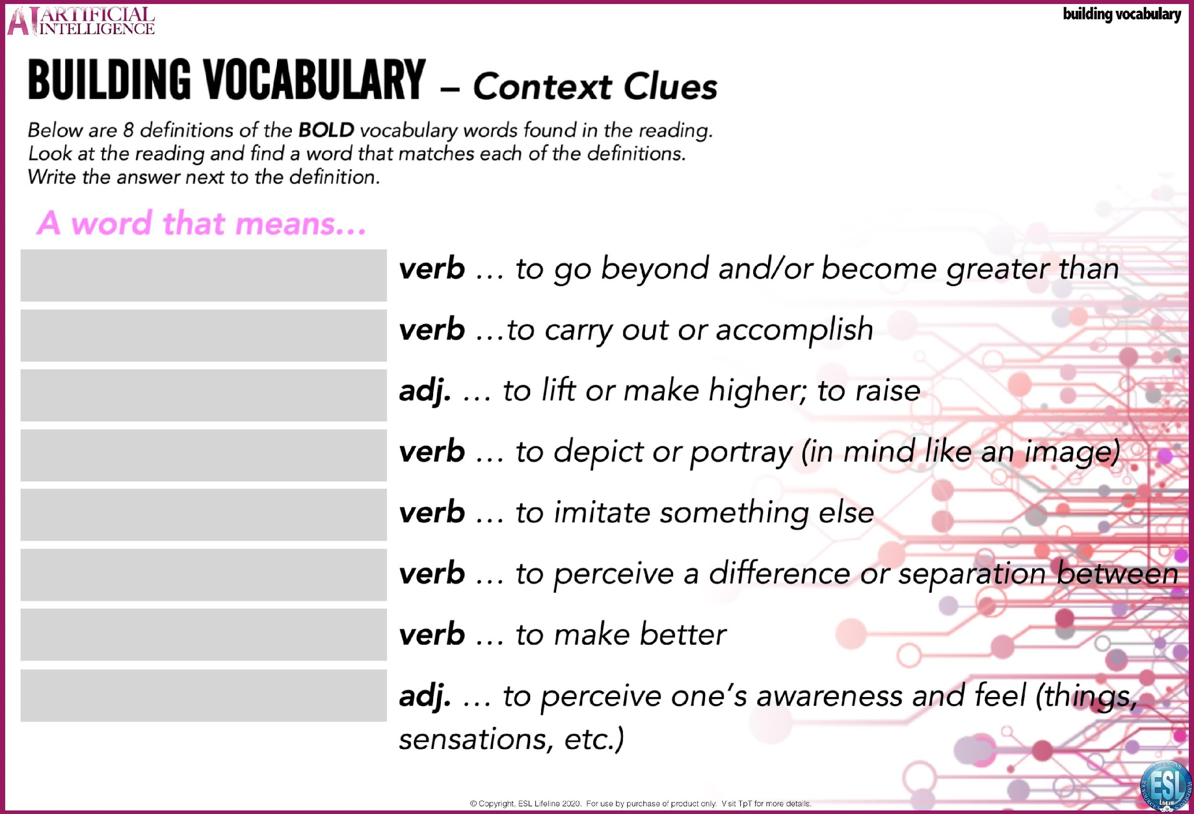
enter text
enter text
enter text
enter text
enter text
enter text
enter text
enter text
Notes:
© Copyright, ESL Lifeline 2020. For use by purchase of product only. Visit TpT for more details.

Slide 6
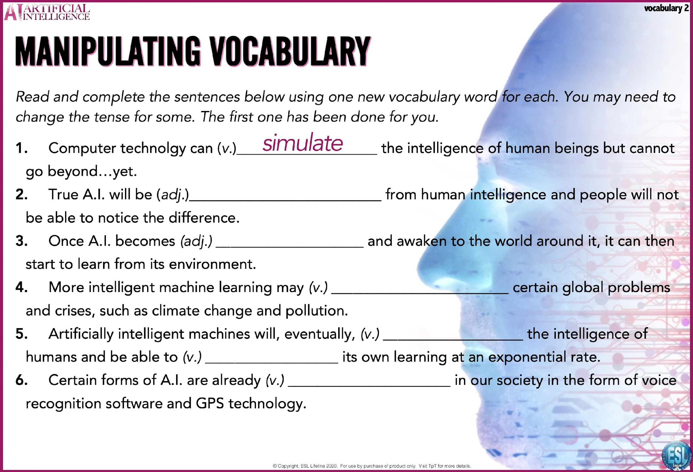
enter text
enter text
enter text
enter text
enter text
enter text
Notes:
© Copyright, ESL Lifeline 2020. For use by purchase of product only. Visit TpT for more details.

Slide 7
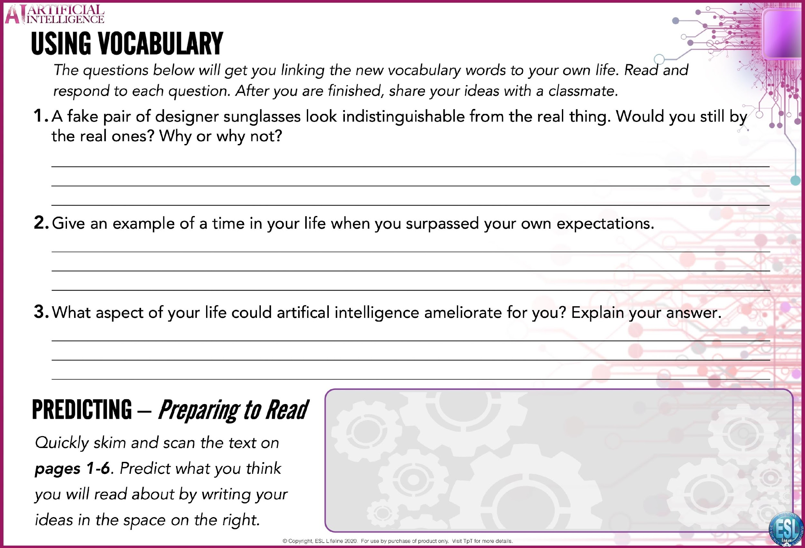
enter text
enter text
enter text
enter text
Notes:
© Copyright, ESL Lifeline 2020. For use by purchase of product only. Visit TpT for more details.

Slide 8
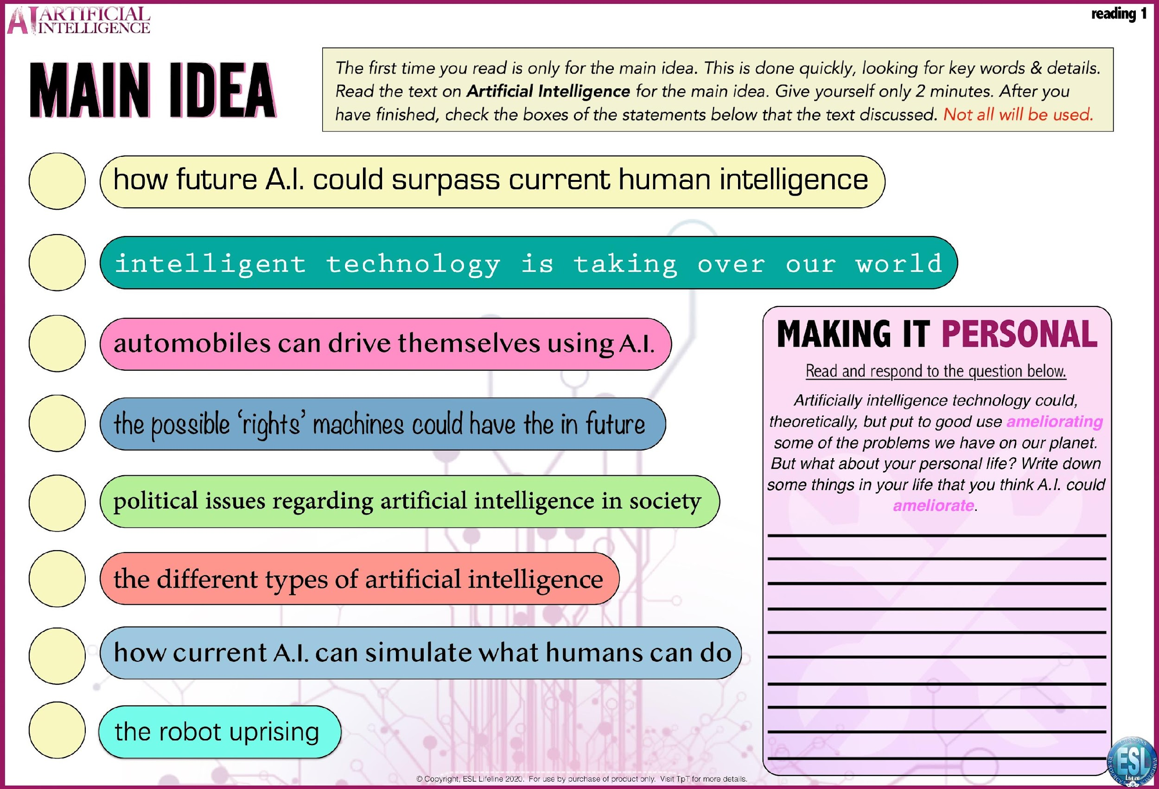

drag n’ drop
enter text
Notes:
© Copyright, ESL Lifeline 2020. For use by purchase of product only. Visit TpT for more details.

Slide 9
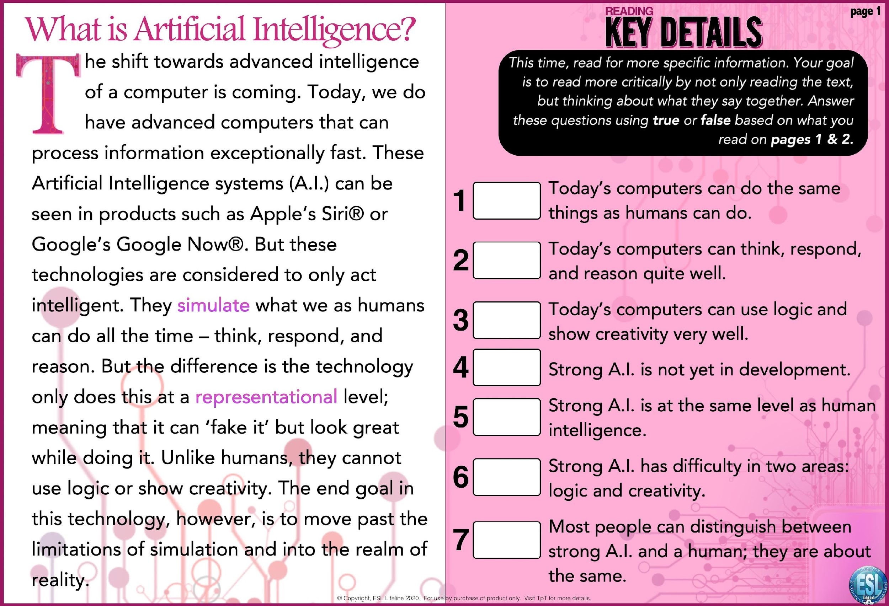
enter text
enter text
enter text
enter text
enter text
enter text
enter text
Notes:
© Copyright, ESL Lifeline 2020. For use by purchase of product only. Visit TpT for more details.

Slide 10
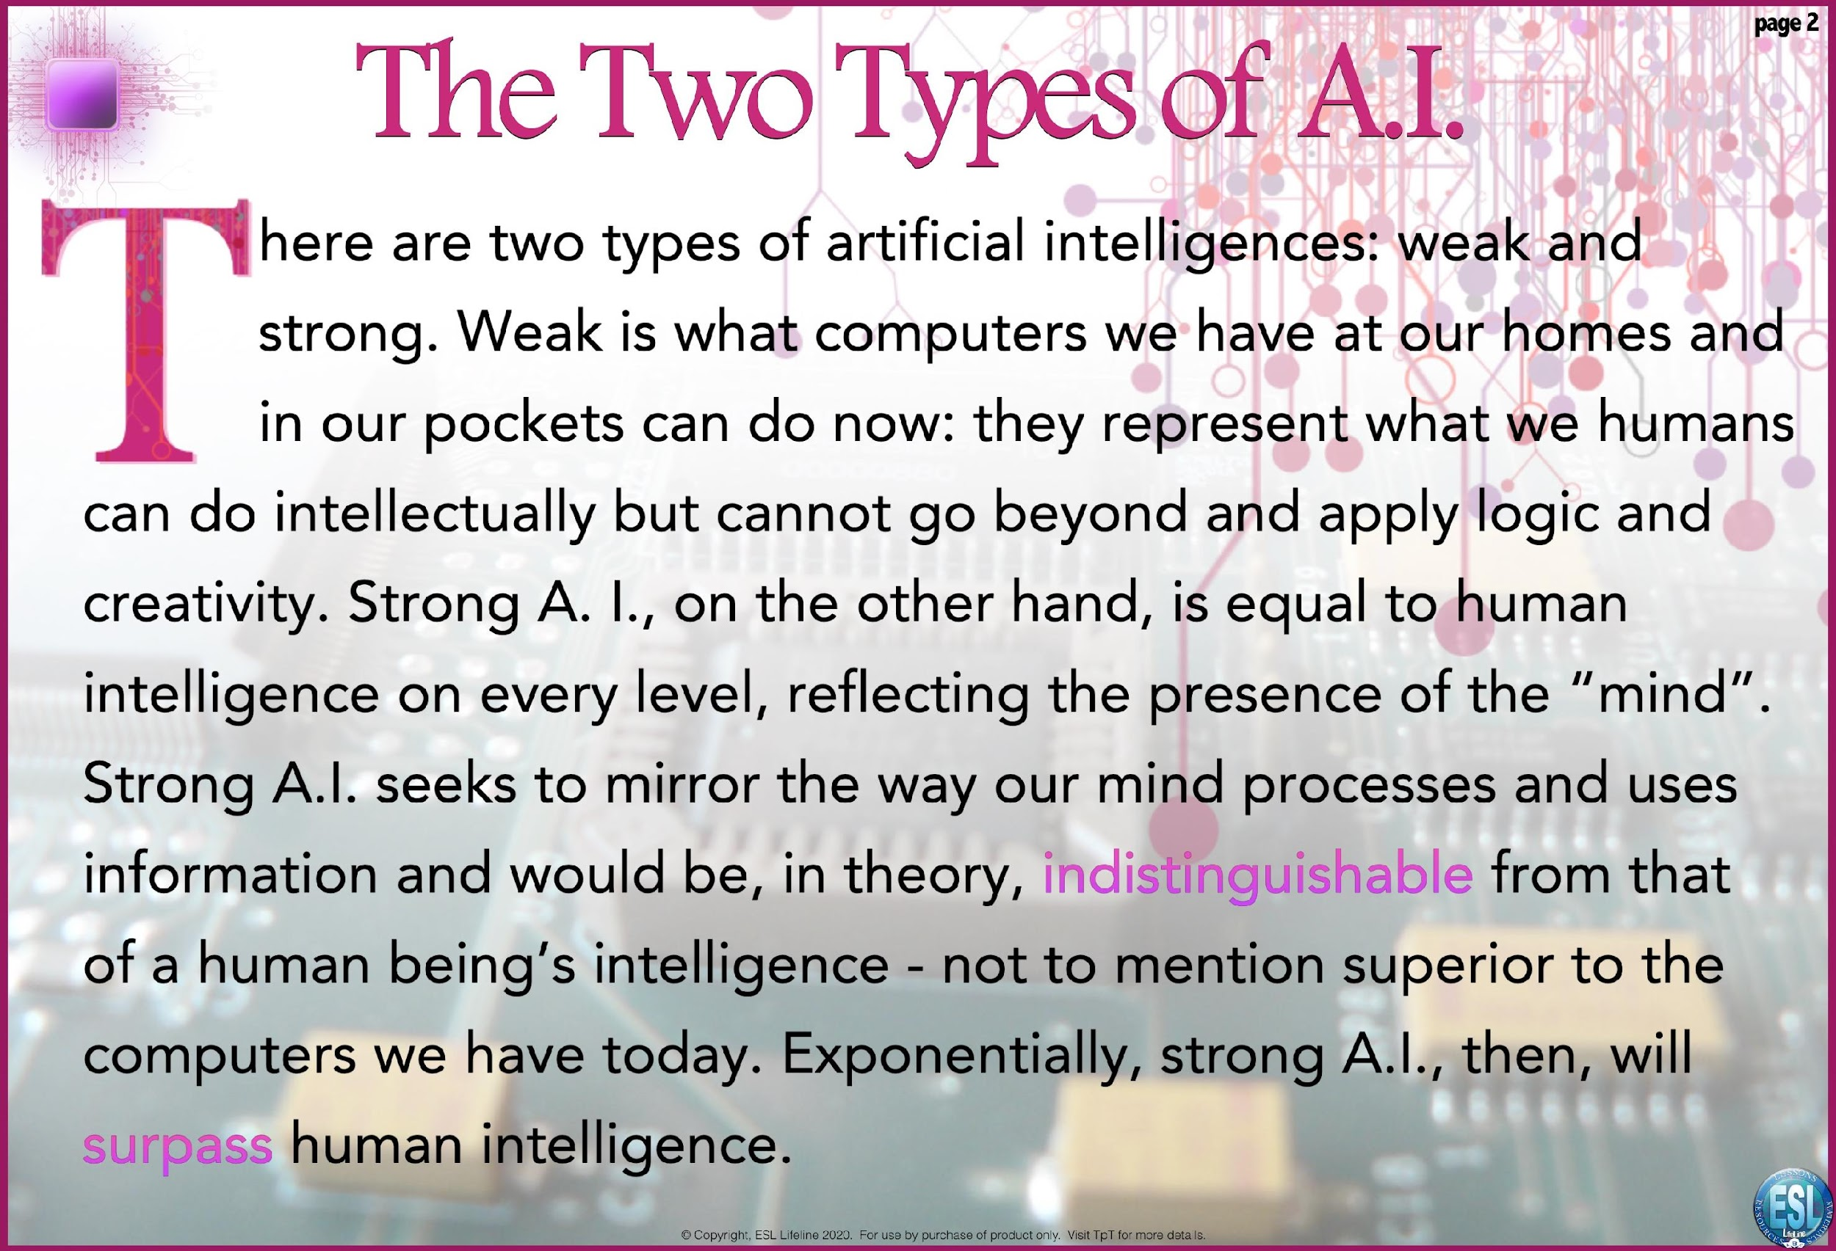
Notes:
© Copyright, ESL Lifeline 2020. For use by purchase of product only. Visit TpT for more details.

Slide 11
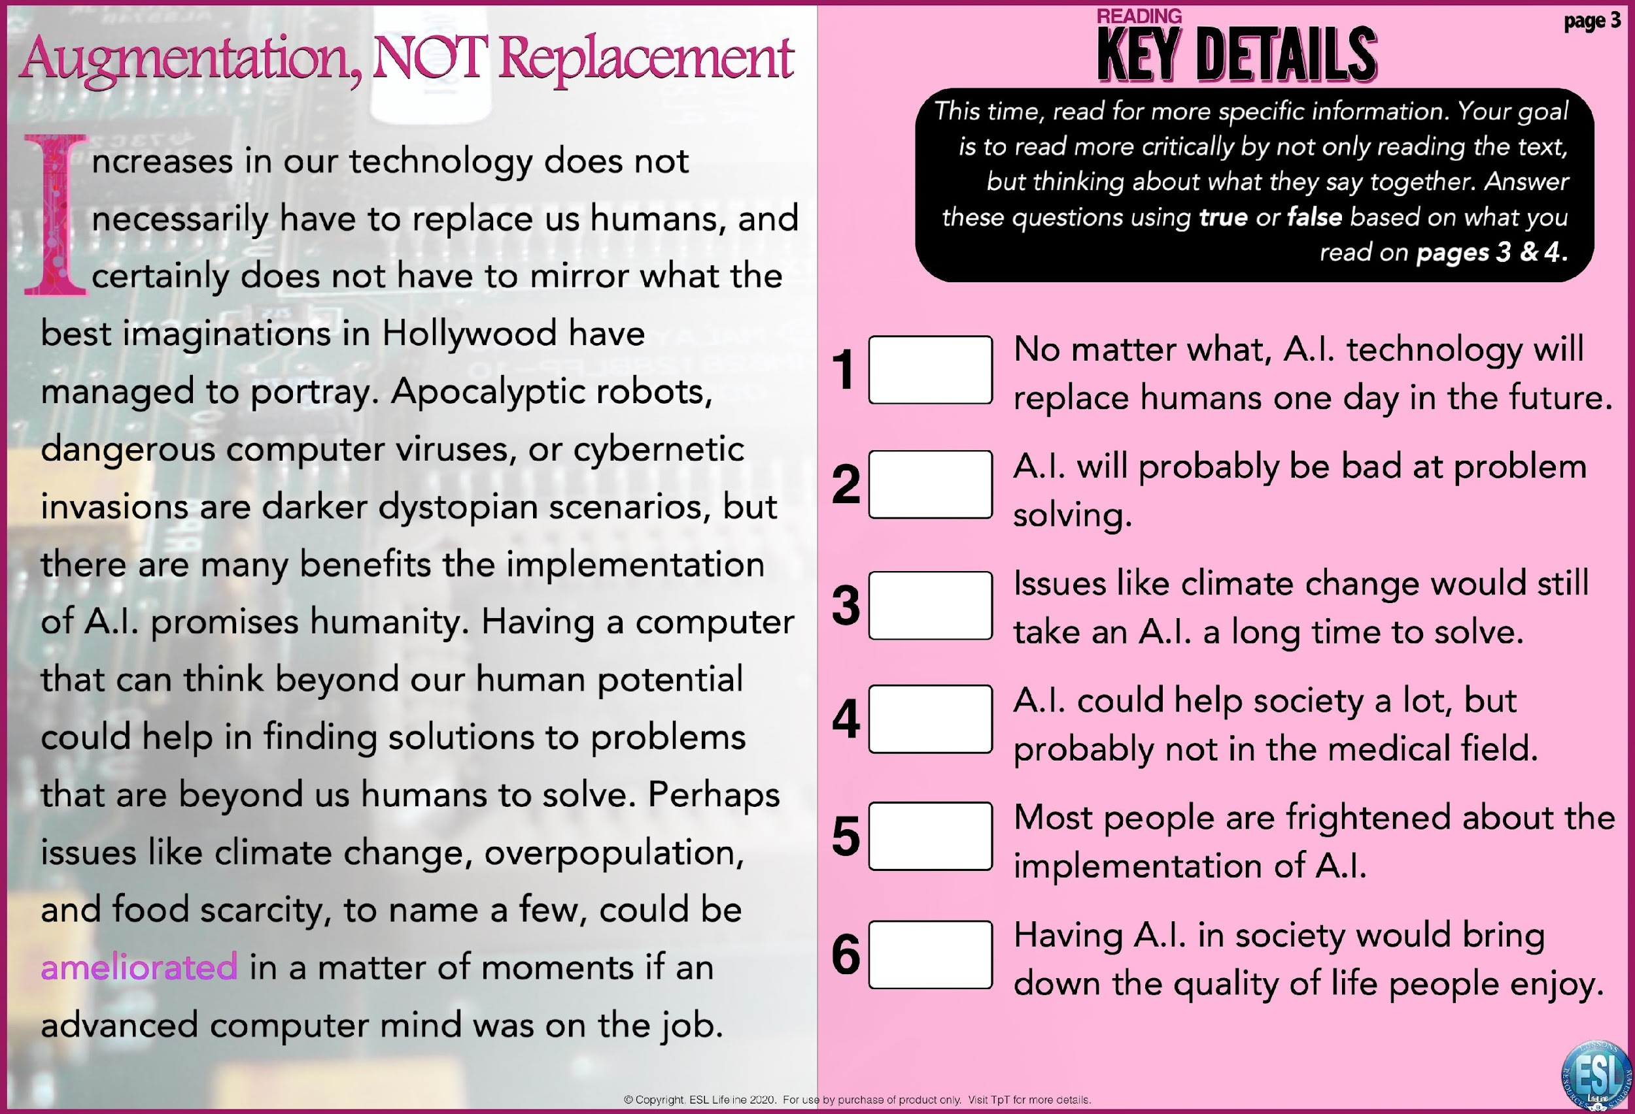
enter text
enter text
enter text
enter text
enter text
enter text
Notes:
© Copyright, ESL Lifeline 2020. For use by purchase of product only. Visit TpT for more details.

Slide 12

Notes:
© Copyright, ESL Lifeline 2020. For use by purchase of product only. Visit TpT for more details.

Slide 13
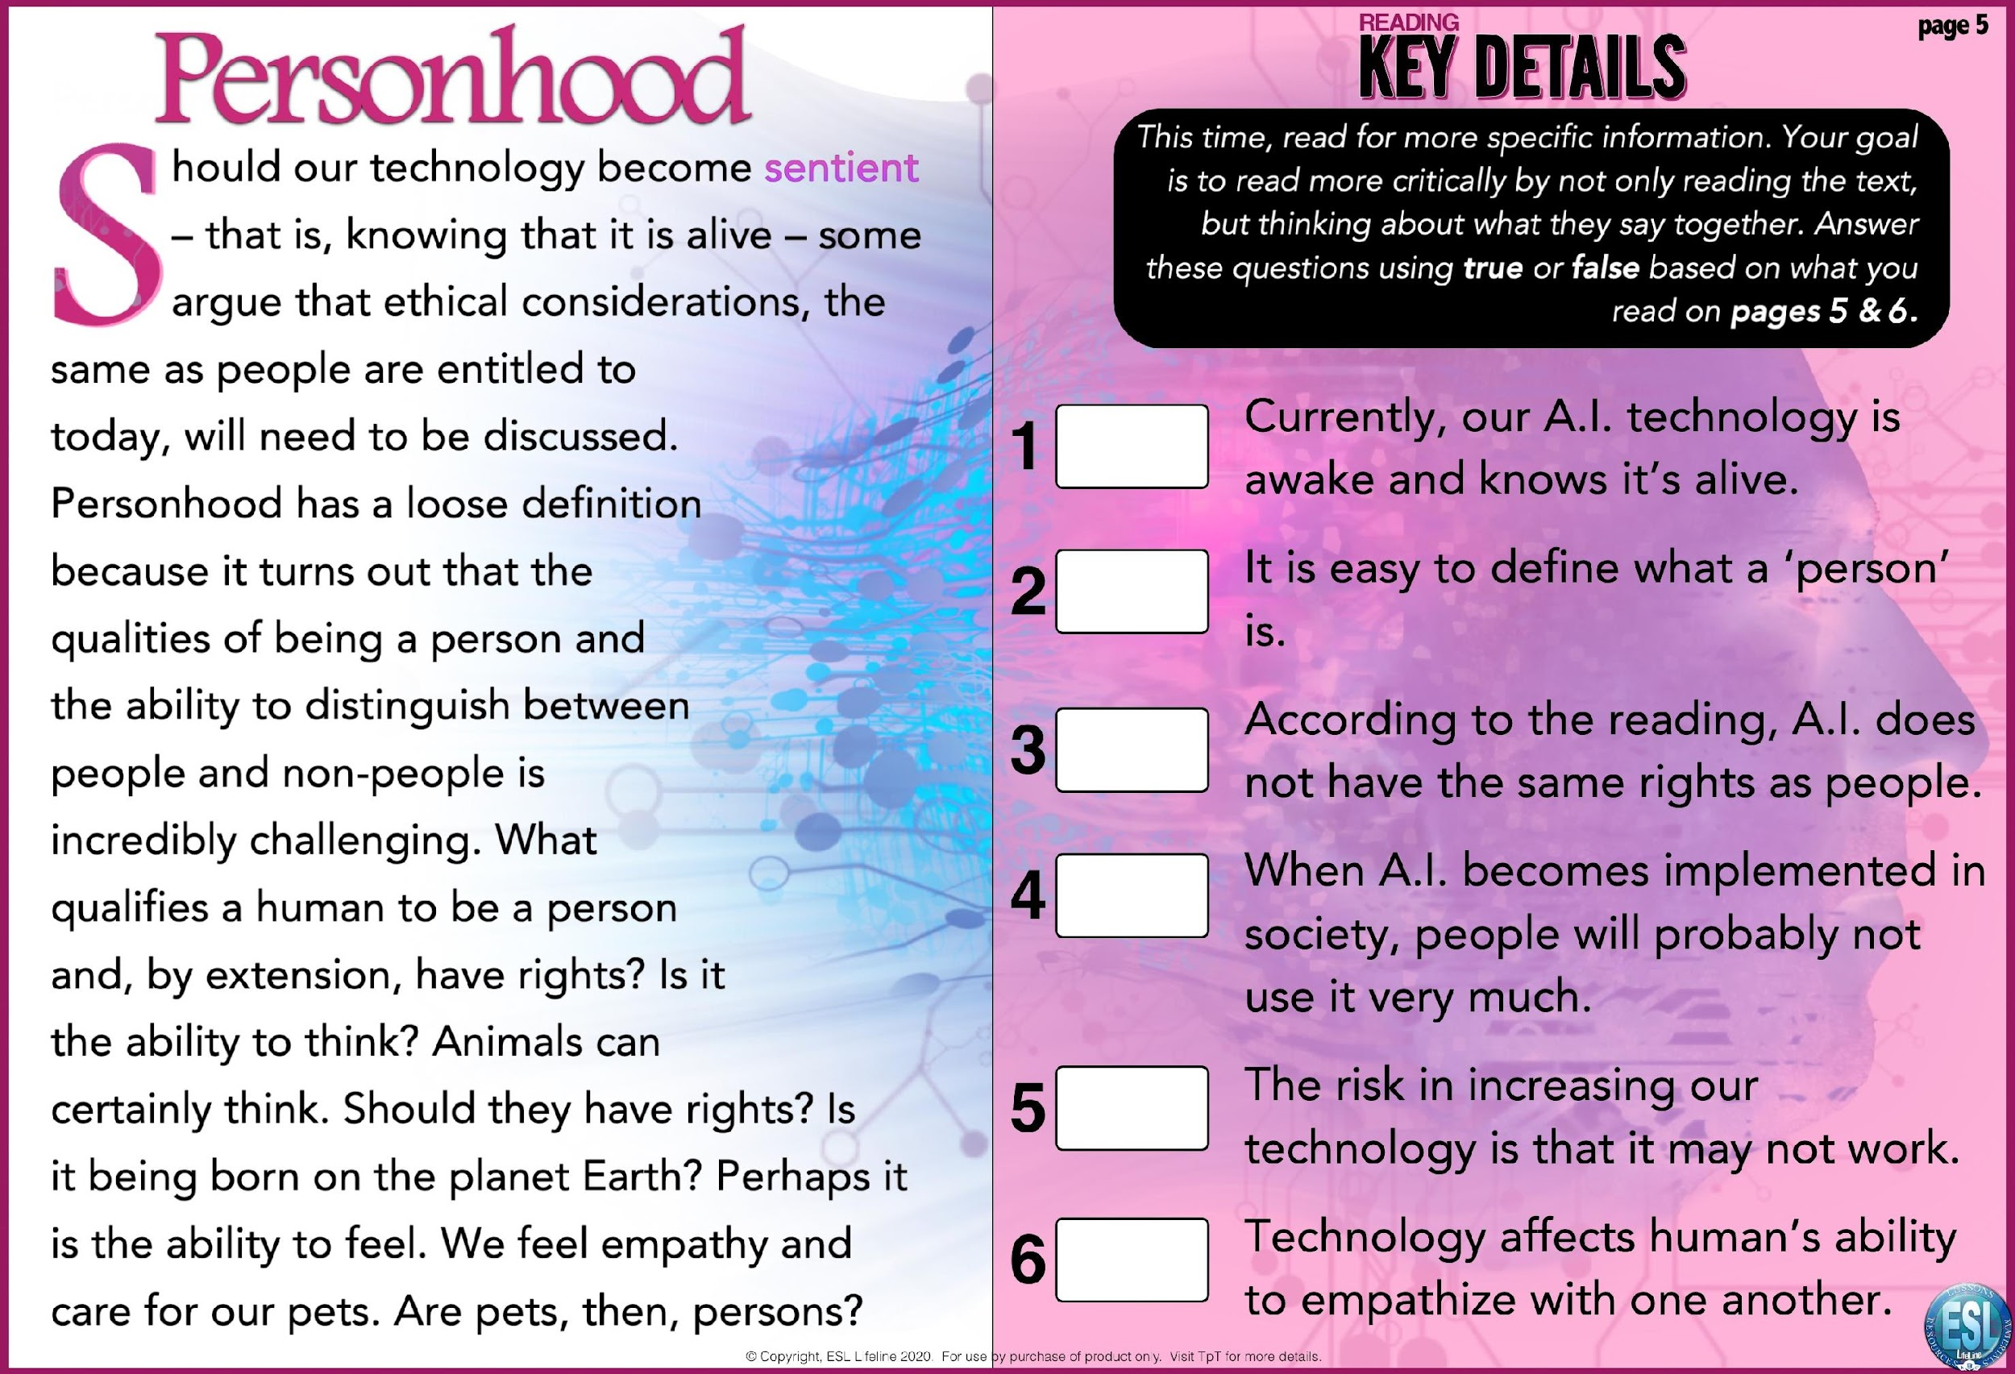
enter text
enter text
enter text
enter text
enter text
enter text
Notes:
© Copyright, ESL Lifeline 2020. For use by purchase of product only. Visit TpT for more details.

Slide 14
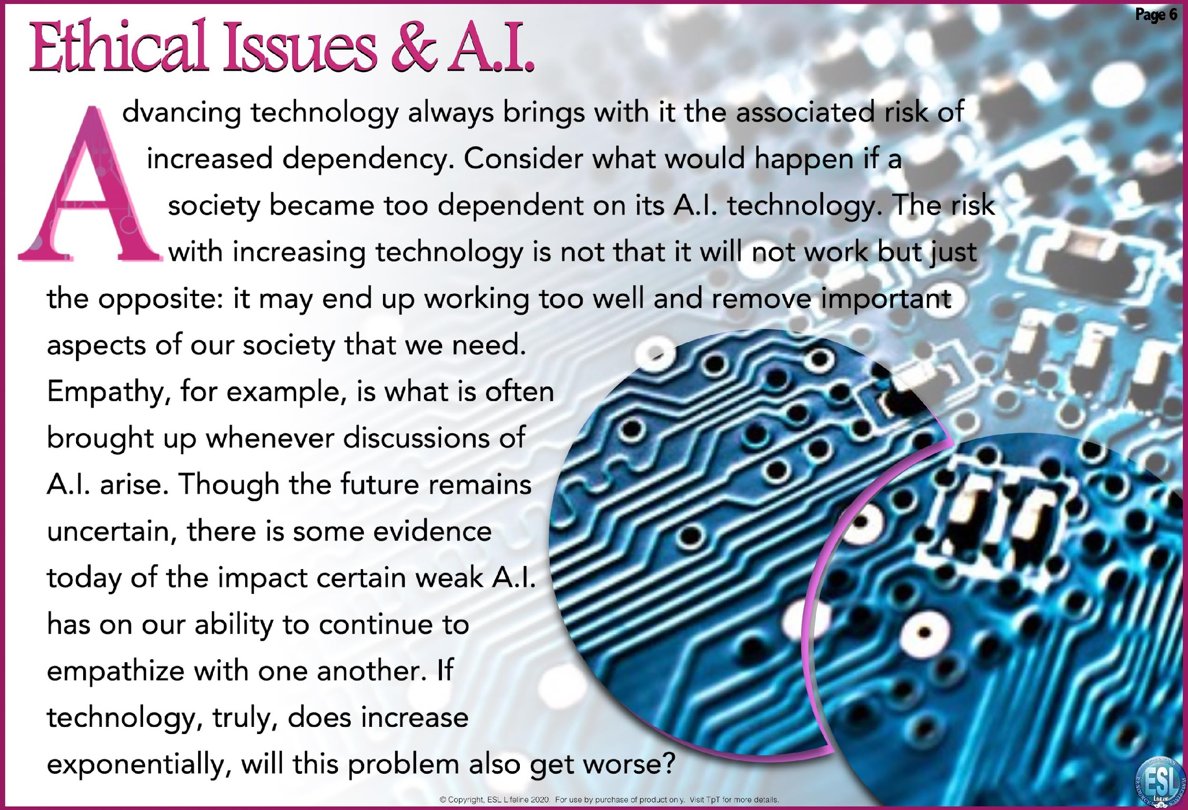
Notes:
© Copyright, ESL Lifeline 2020. For use by purchase of product only. Visit TpT for more details.

Slide 15
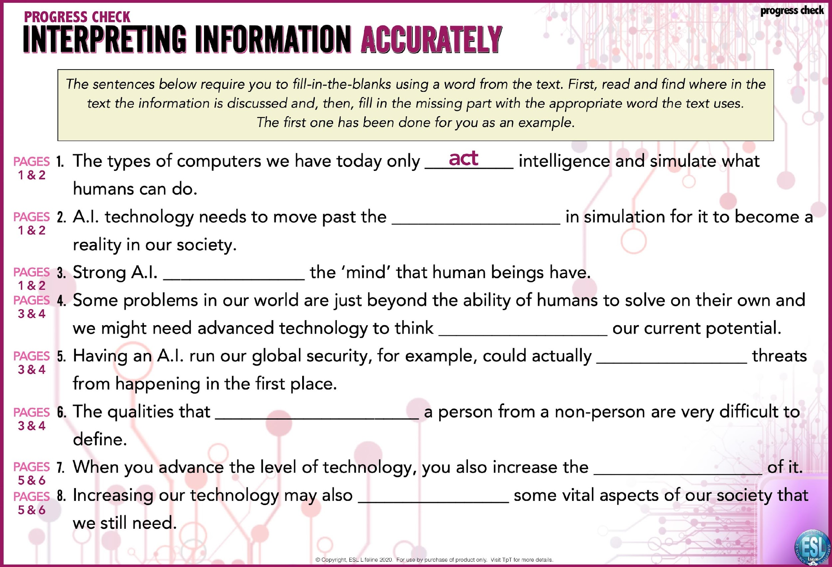
enter text
enter text
enter text
enter text
enter text
enter text
enter text
Notes:
© Copyright, ESL Lifeline 2020. For use by purchase of product only. Visit TpT for more details.

Slide 16
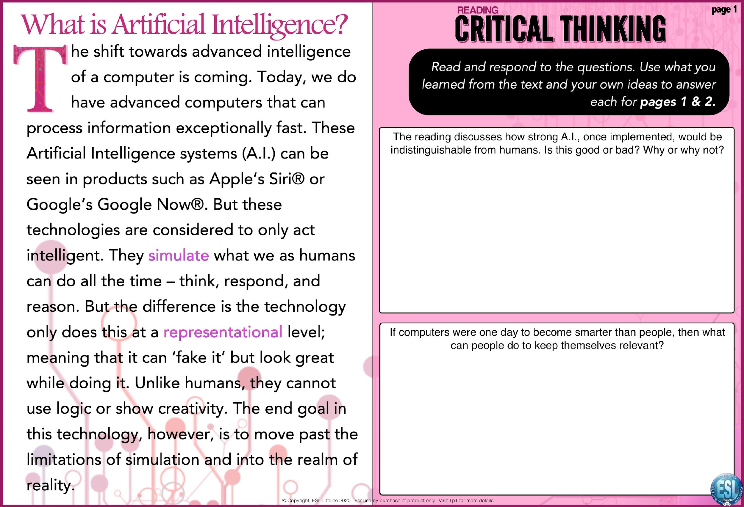
enter text
enter text
Notes:
© Copyright, ESL Lifeline 2020. For use by purchase of product only. Visit TpT for more details.

Slide 17
Notes:
© Copyright, ESL Lifeline 2020. For use by purchase of product only. Visit TpT for more details.

Slide 18
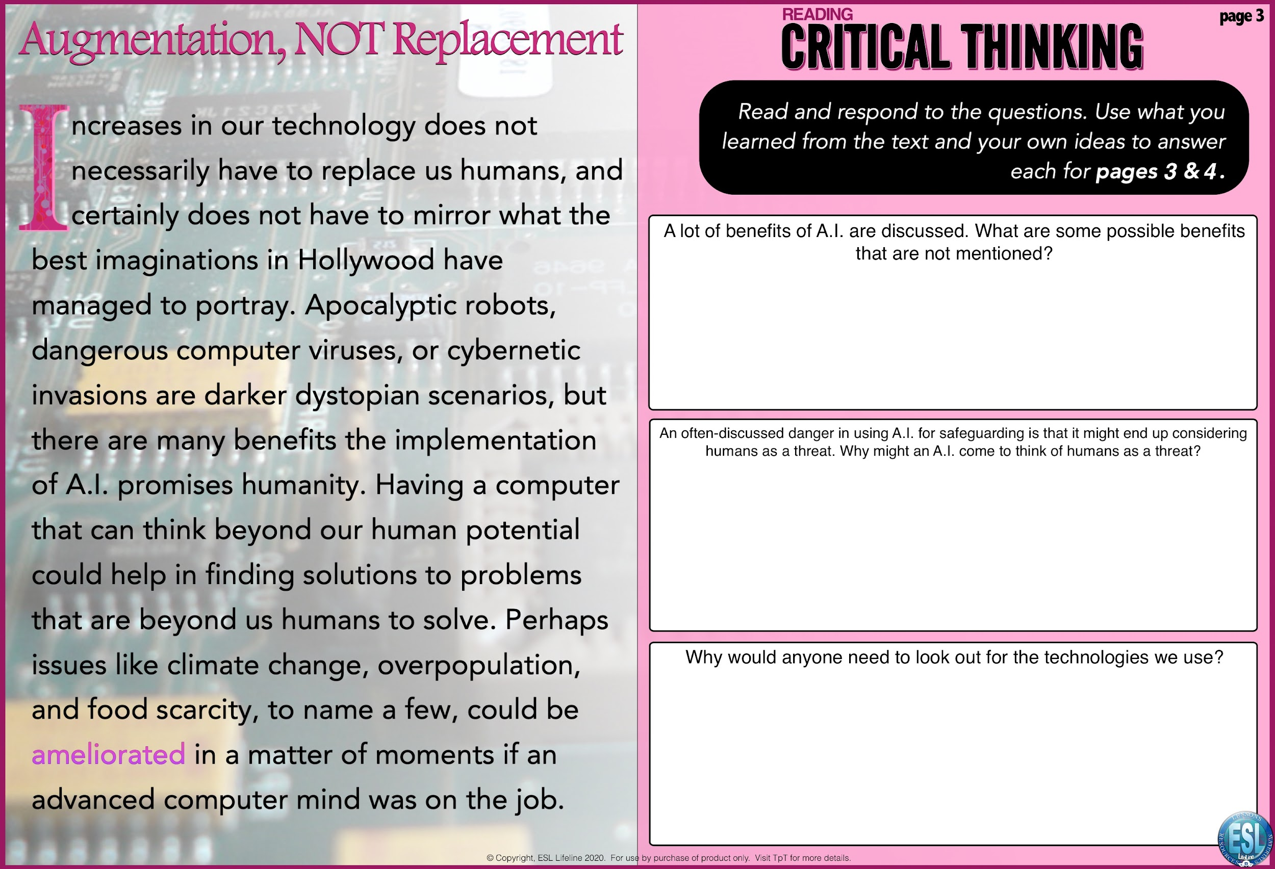
enter text
enter text
enter text
Notes:
© Copyright, ESL Lifeline 2020. For use by purchase of product only. Visit TpT for more details.

Slide 19
Notes:
© Copyright, ESL Lifeline 2020. For use by purchase of product only. Visit TpT for more details.

Slide 20
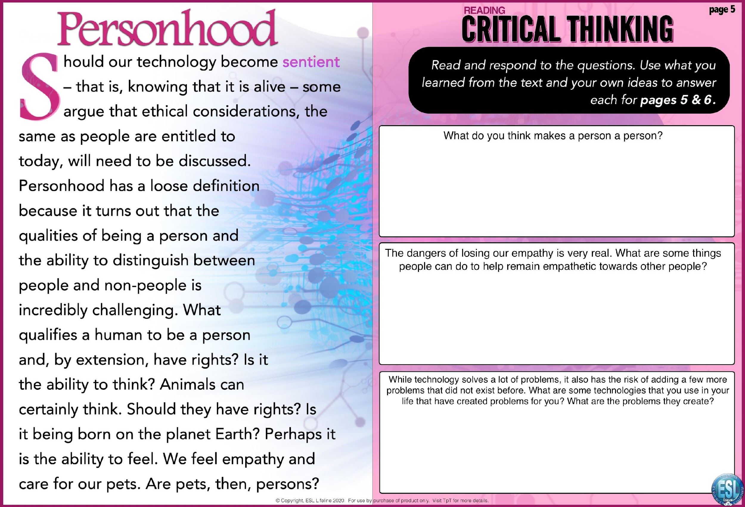
enter text
enter text
enter text
Notes:
© Copyright, ESL Lifeline 2020. For use by purchase of product only. Visit TpT for more details.

Slide 21
Notes:
© Copyright, ESL Lifeline 2020. For use by purchase of product only. Visit TpT for more details.

Slide 22
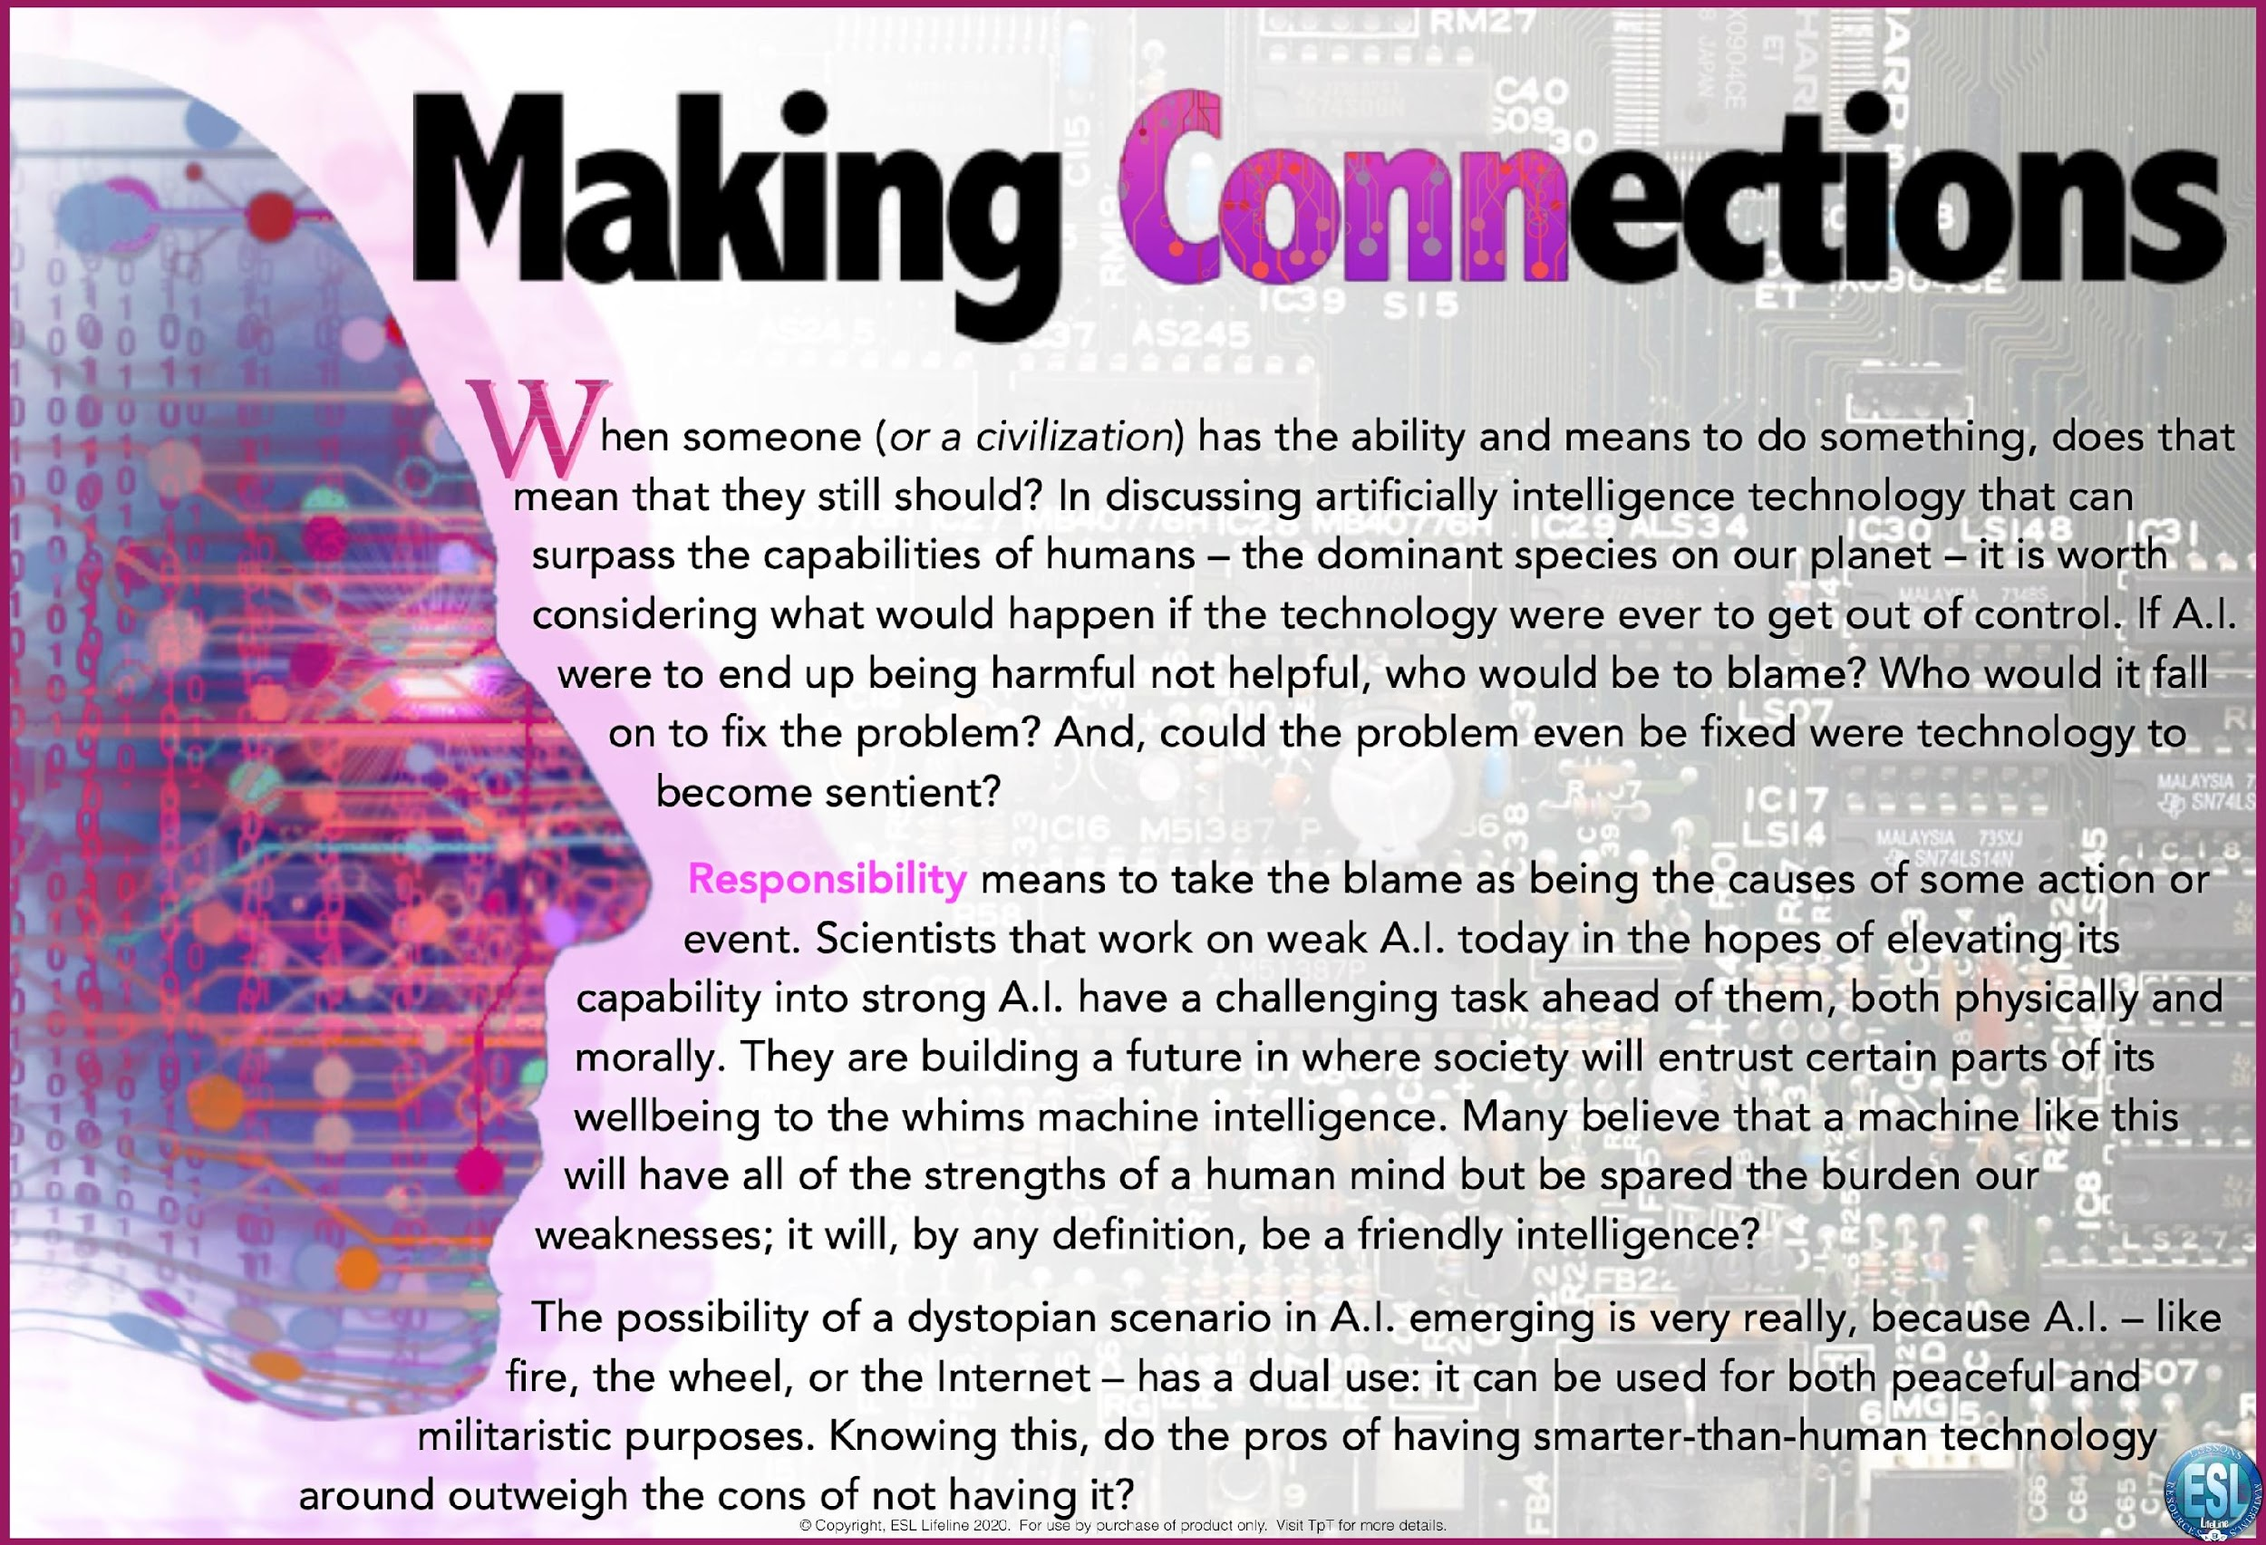
Notes:
© Copyright, ESL Lifeline 2020. For use by purchase of product only. Visit TpT for more details.

Slide 23
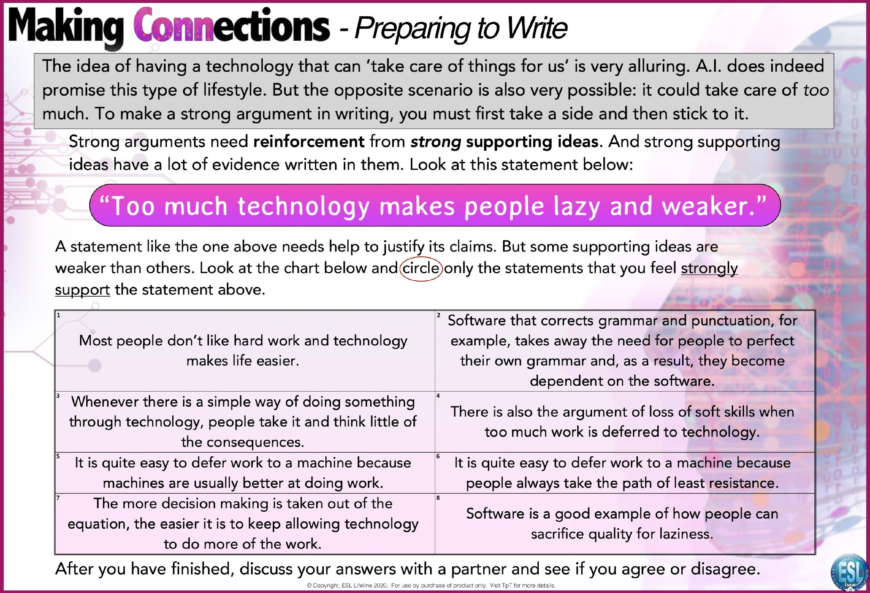
drag n’ drop
drag n’ drop
Notes:
© Copyright, ESL Lifeline 2020. For use by purchase of product only. Visit TpT for more details.

Slide 24
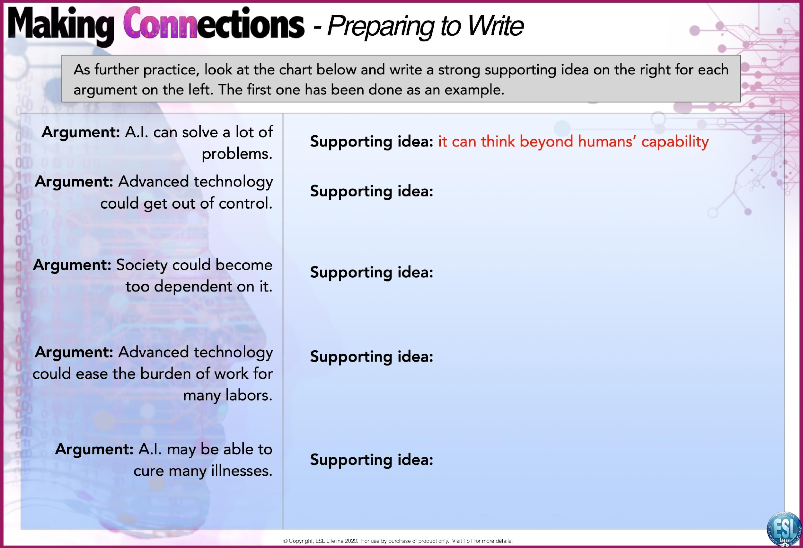
enter text
enter text
enter text
enter text
Notes:
© Copyright, ESL Lifeline 2020. For use by purchase of product only. Visit TpT for more details.

Slide 25
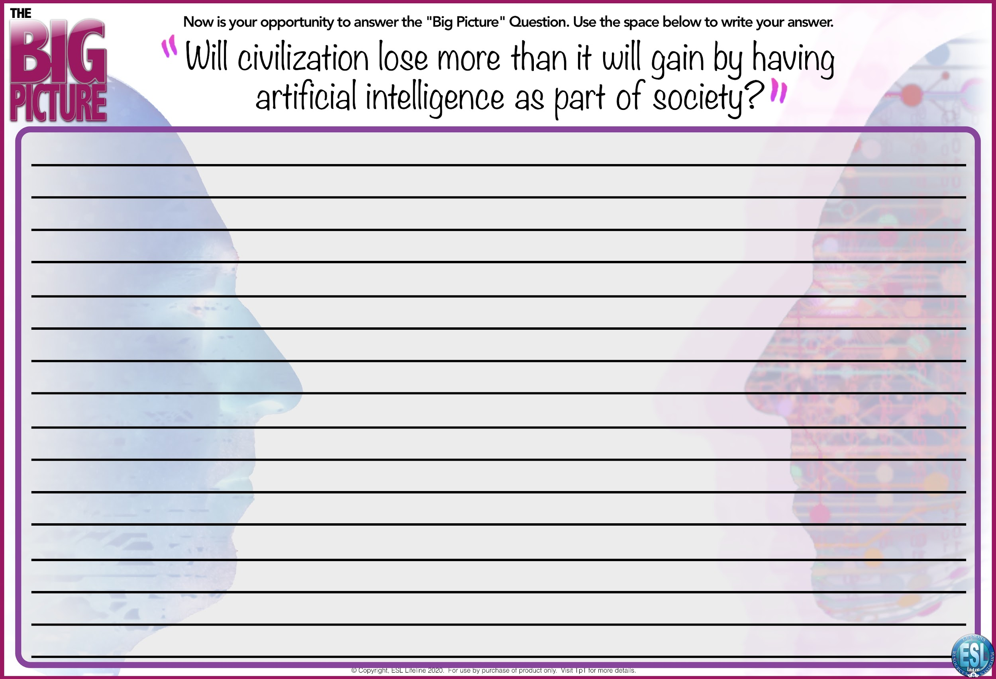
enter text

Slide 26
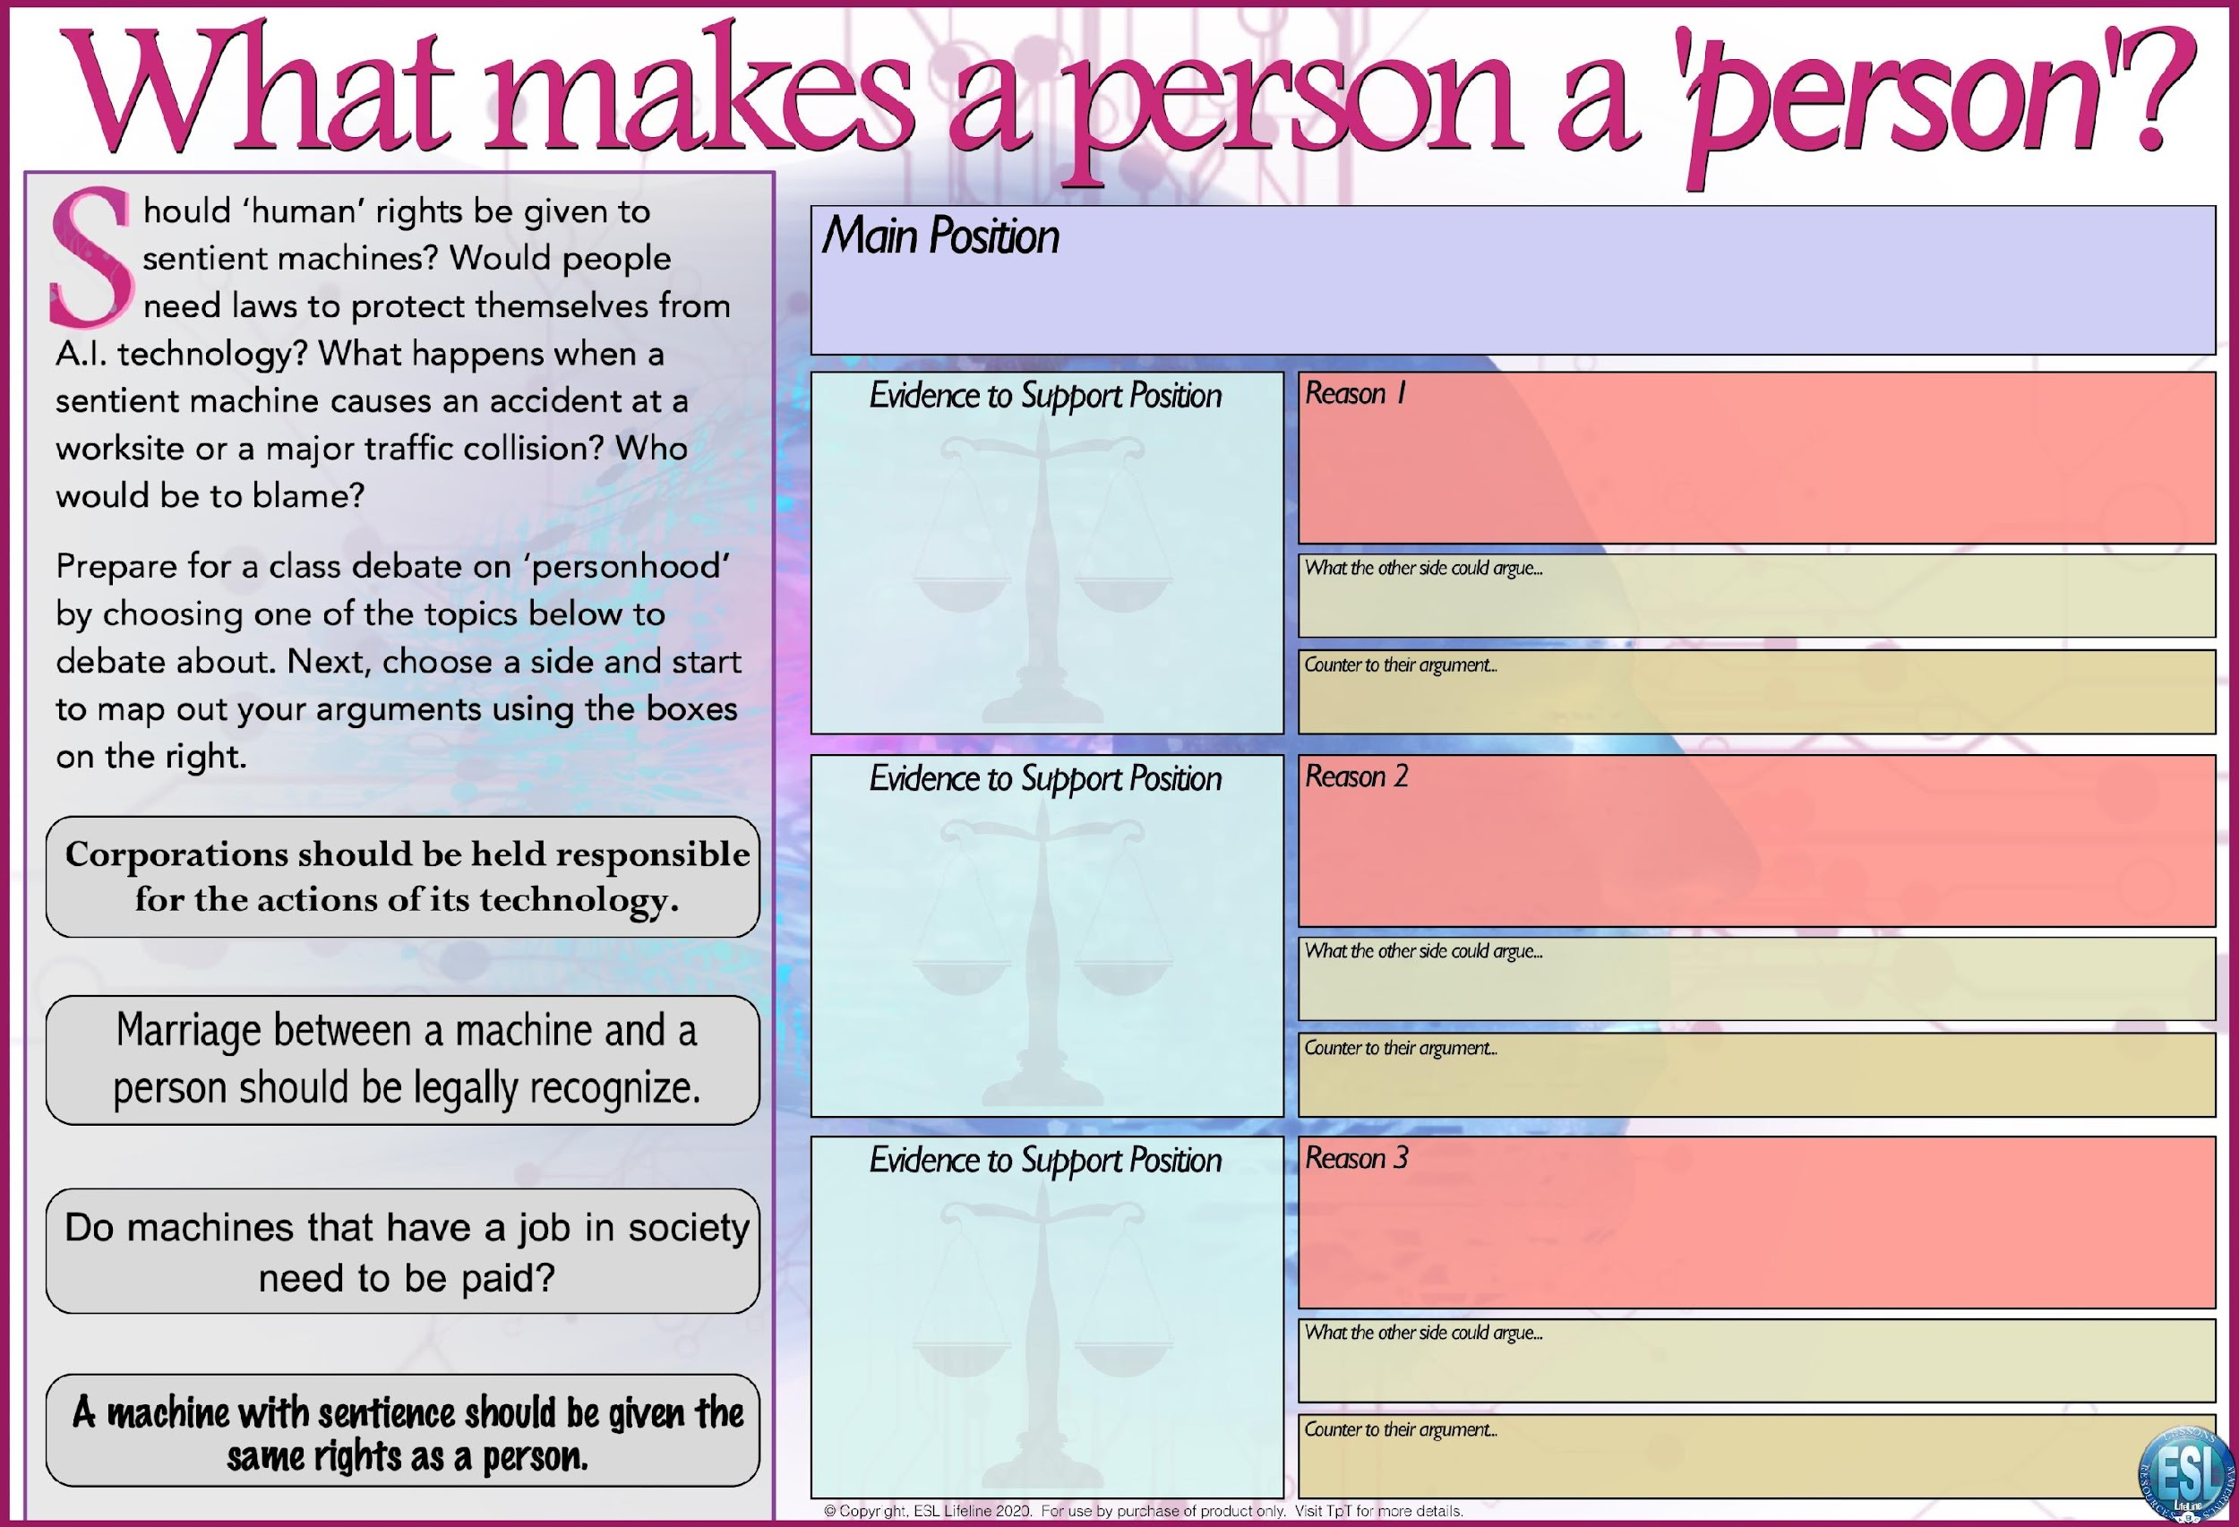
enter text
enter text
enter text
enter text
enter text
enter text
enter text
enter text
enter text
enter text
enter text
drag n’ drop to circle your choice
enter text
enter text
Notes:
© Copyright, ESL Lifeline 2020. For use by purchase of product only. Visit TpT for more details.

Slide 27
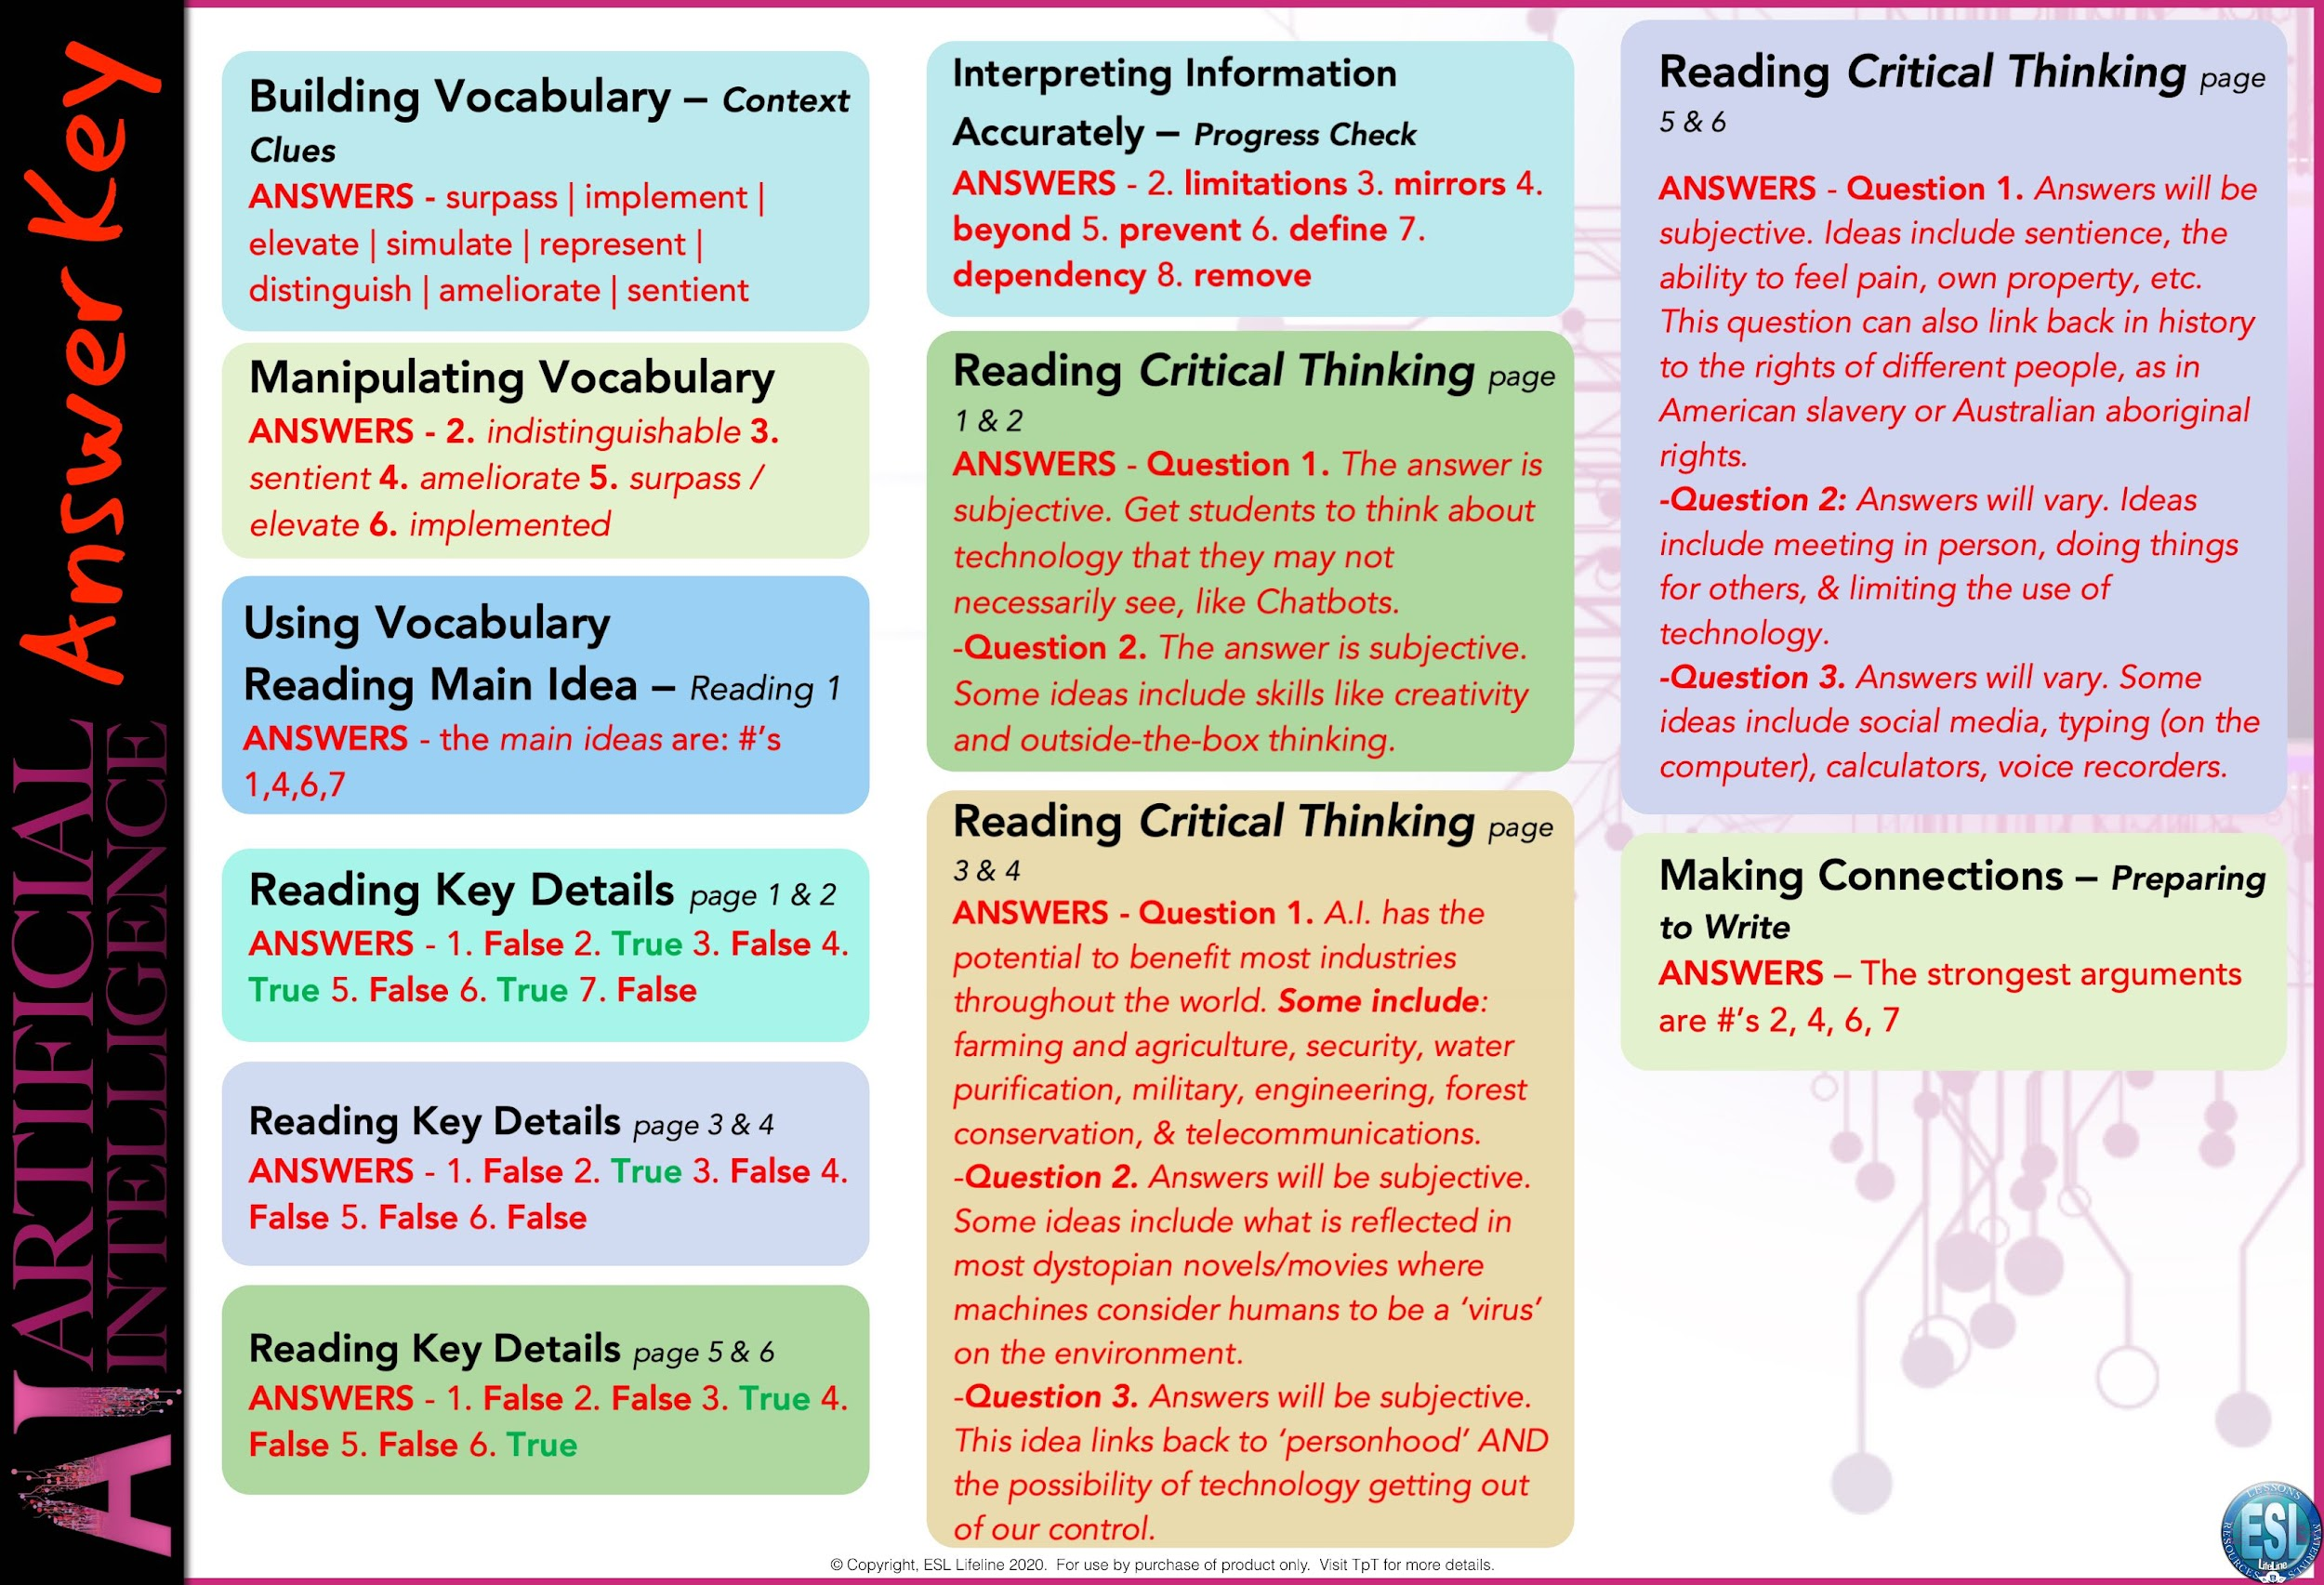

Slide 28
